Slide 1
CS-Studio: Data Browser

Slide 2
Data Browser
Display “live” and historic values of process variables.
Notes:
What is data browser

Slide 3
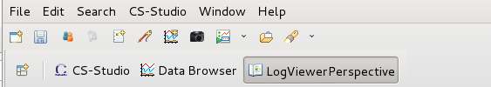
Data Browser - Getting Started
Running Data Browser
Menu: CSS → Trends → Data Browser
Toolbar: click on the open “Open New Data Browser Plot” icon in the toolbar
Context Menu*: Process Variable → Data Browser
Notes:
E: how to open databrowser
Menu
Toolbar
Add the the motor pv’s associated with the val, rbv, moving

Slide 4
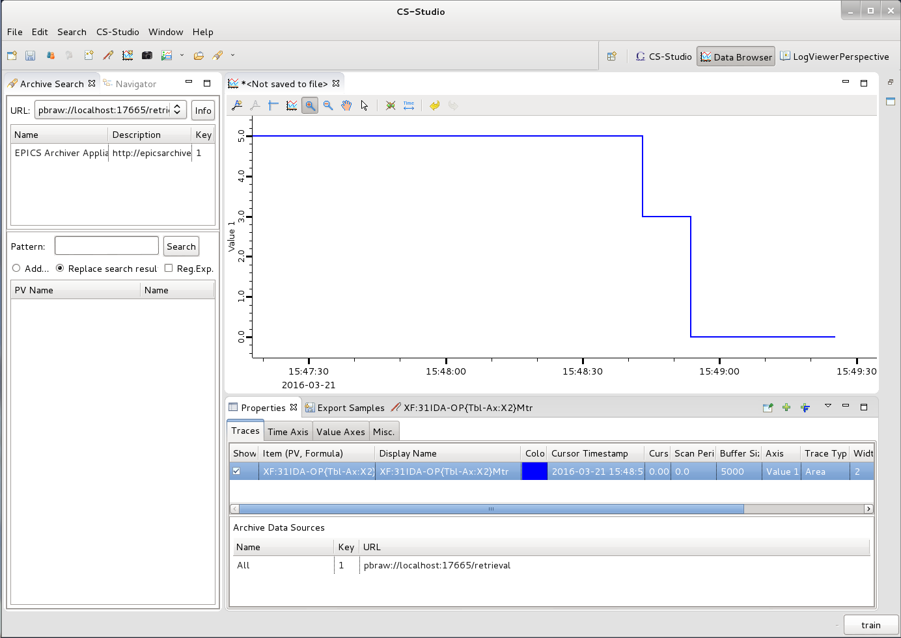
Data Browser Perspective
Open from context menu
Window→Open Perspective→Other Databrowser Perspective
Plot
Archive Search View
Properties View
Traces
Time Axis
Value Axis
Misc
Export Samples View

Slide 5
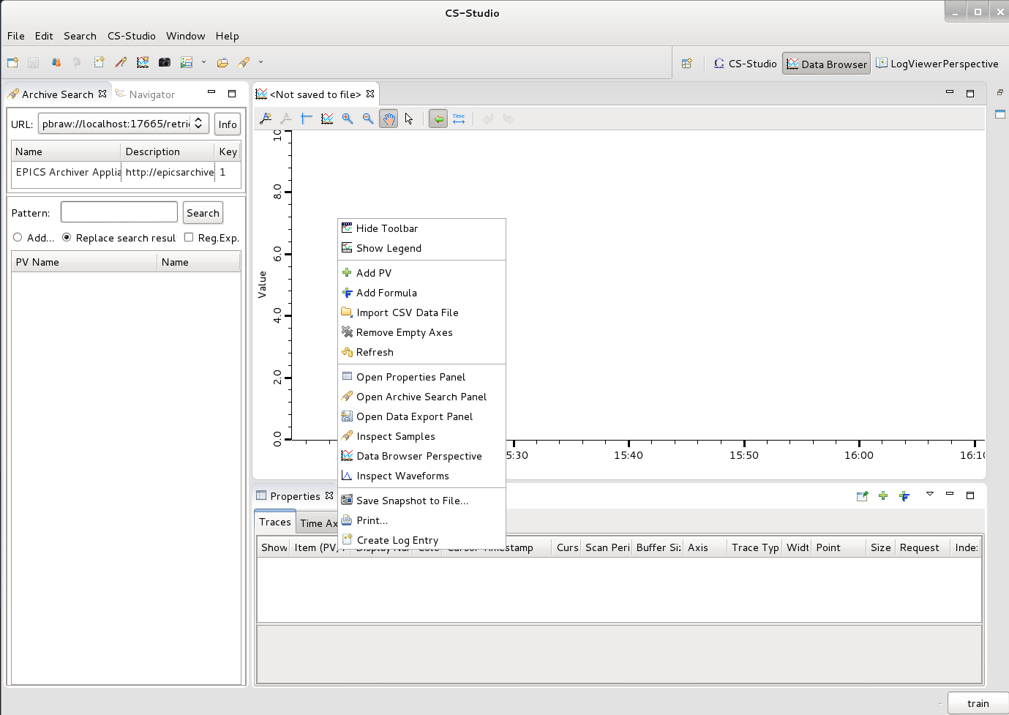
Adding PV’s
Right click → Add PV Name: XF:31IDA-OP{Tbl-Ax:X2}Mtr
Notes:
Databrowser screenshot – overview

Slide 6
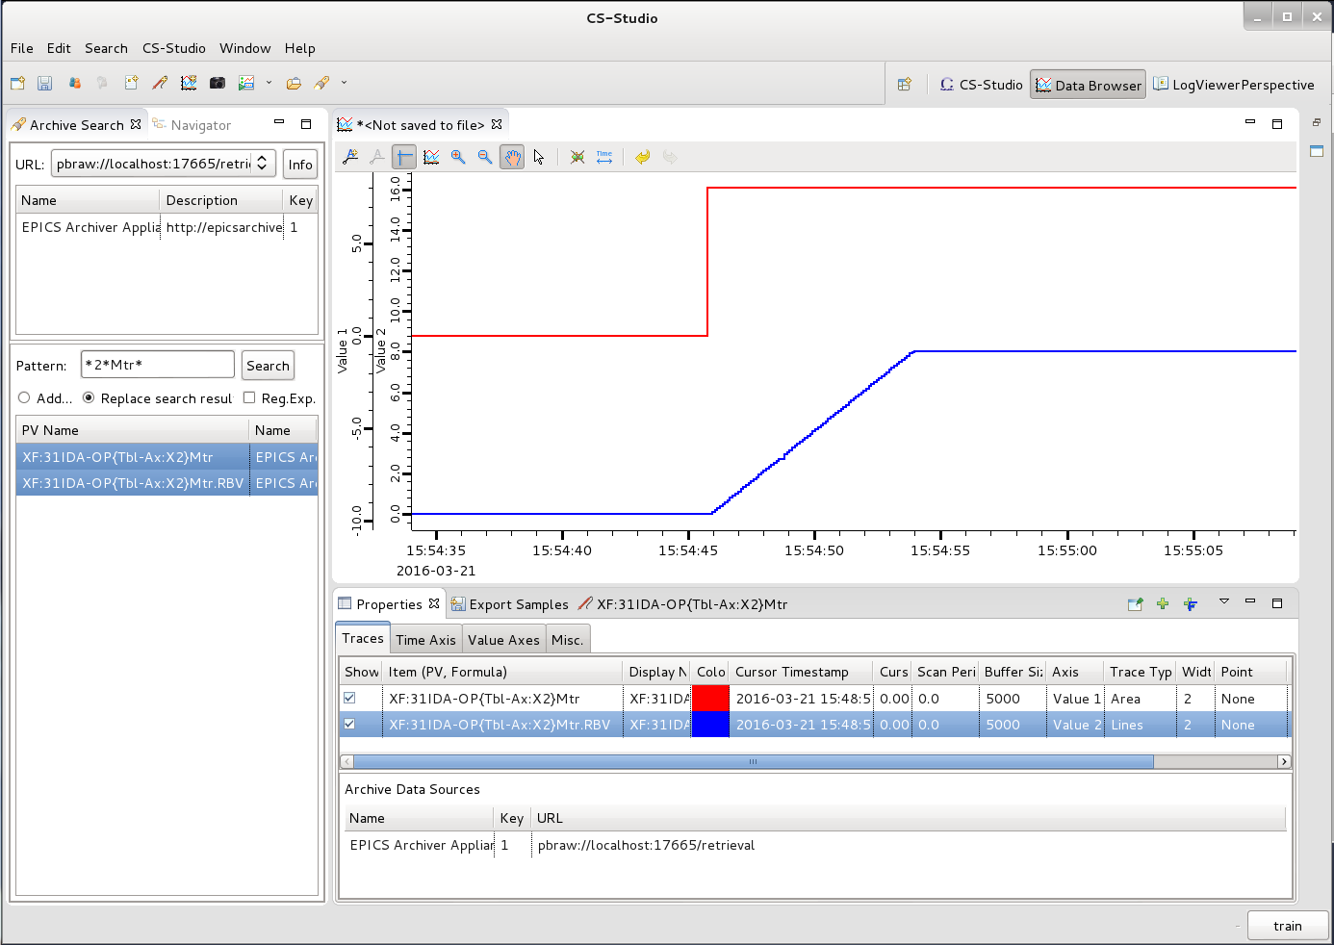
Searching for PV’s
Archive search view
Select Archive: default/current
Pattern : *2*Mtr*
Right click (open context menu) → Process Variable → Data Browser
Notes:
E:
Add PV’s
Modify the time axis
Combine value axis

Slide 7
Data Browser Details
Plot Toolbar
zoom in and out, rubber band zoom, scroll back and forth in time,….
Traces View
List of PV’s being displayed, the Visual characteristics of the traces associated with the PV’s, and list of Data sources
Time Axis View
Define start and end time of the plot in either relative or absolute terms
Value Axis View
Manage the Y Axis/Axes, i.e. colour, range,….
Notes:
Exercise
Play around a bit
Combine the SP and RB into one axis
Set the axis as fixed
Color
Time ranges
Save .plt file
Open .plt file

Slide 8
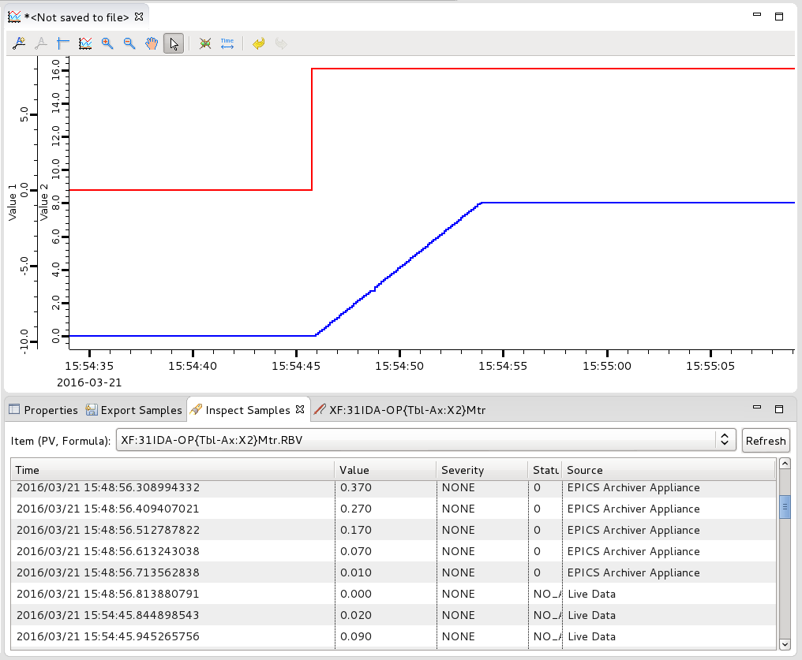
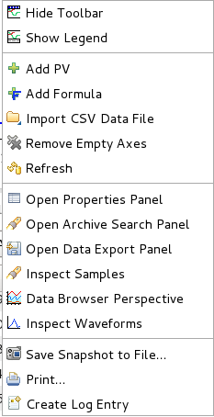
Data Browser Inspect samples
Allows inspection of pv values being plotted.
Context Menu → Inspect Samples
Notes:
Export data

Slide 9
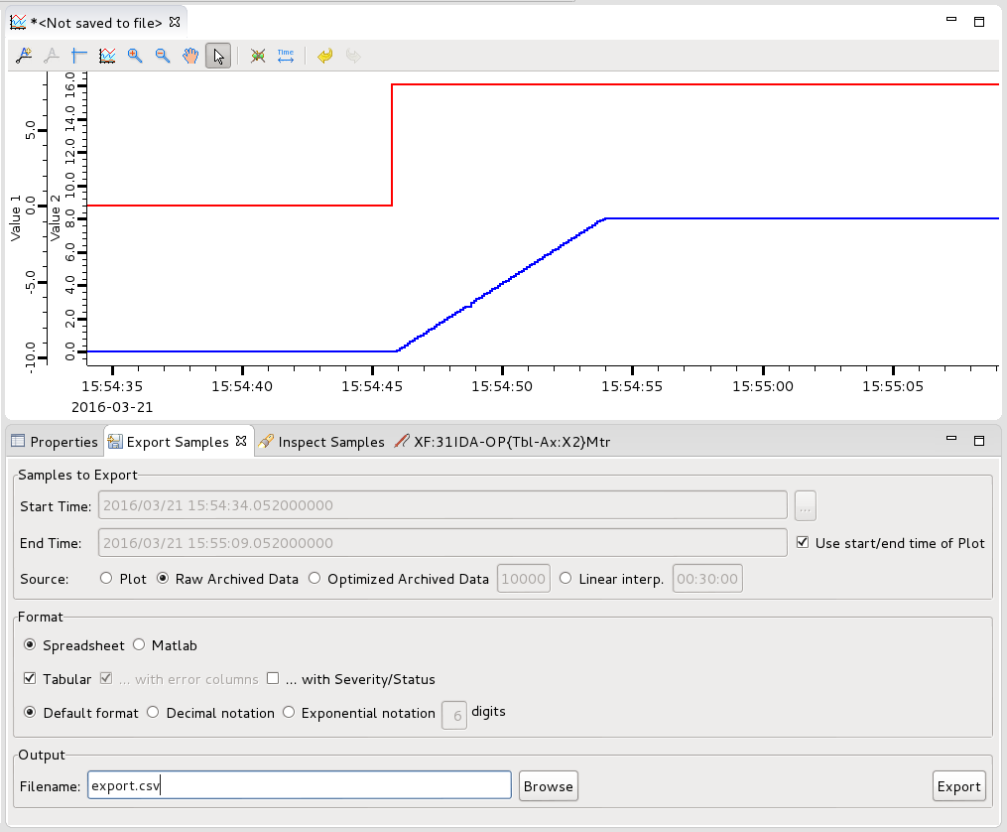
Data Browser Export
Samples to Export: Define the amount and the source of the data to be exported.
Format: Select the output format exported for the data.
Output: Select the output file.
Notes:
Export data

Slide 10
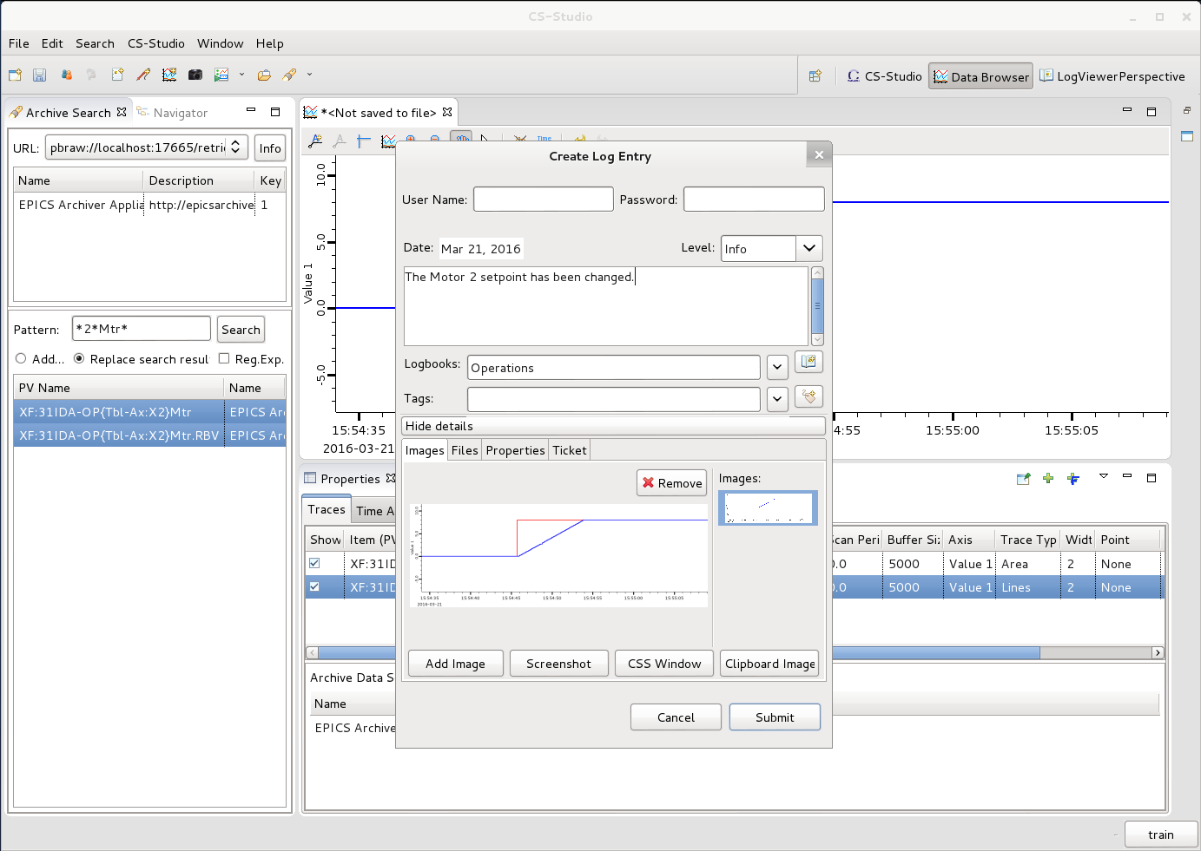
Create log entry
Context menu (right click) →
Create log entry
A log Entry dialog pre populated with appropriate data depending on which application you are making the log entry from
Username:
password:
Exercise:
Create a log entry, with some text and plot
Exercise:
Create a log entry with – text, plot and .plt file
Notes:
Create log Entry
Log entry with context

Slide 11
More Information
Help
Help → Help Contents → CSS Applications → Data Browser

